Slide 1
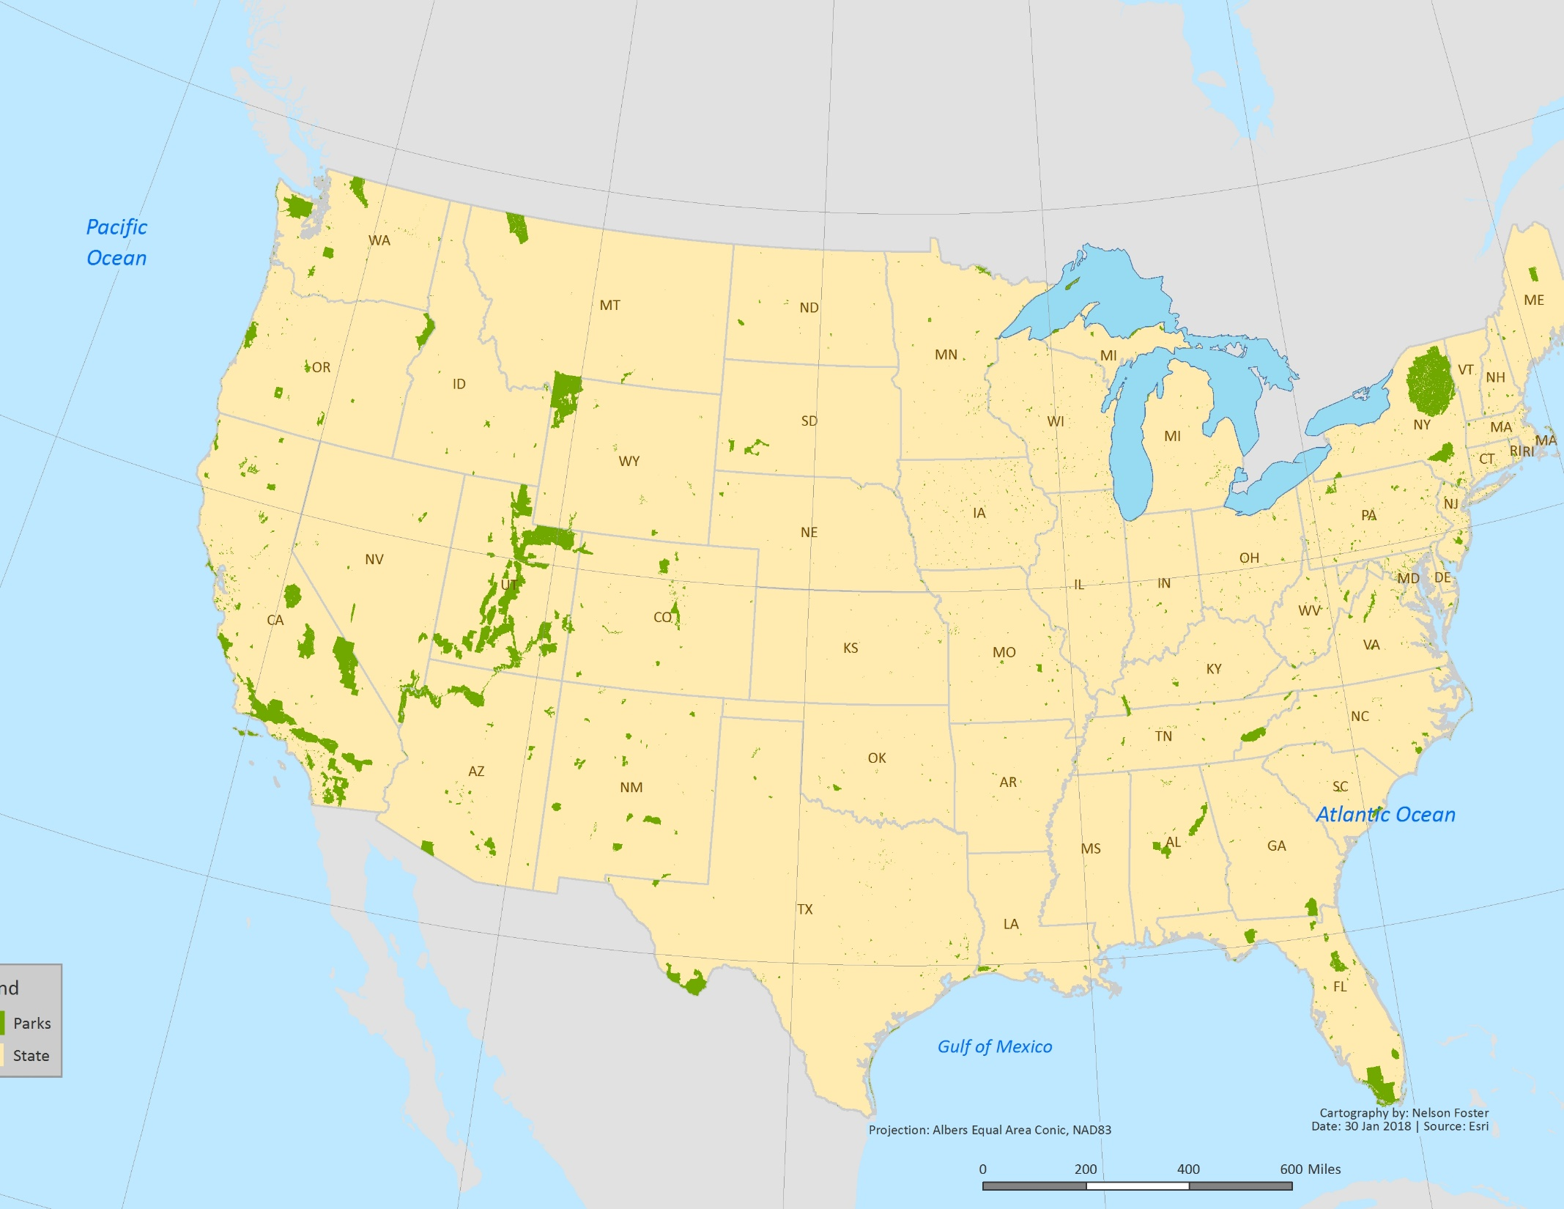
Looks like your map was cut off, missing title, legend cut off, etc.
I think you made your layout too big, bigger than the page.
Decent except for cropping and parks colors
8.25/10
Colors are good though you lose the state names over the parks, like in UT
Cut off

Slide 2
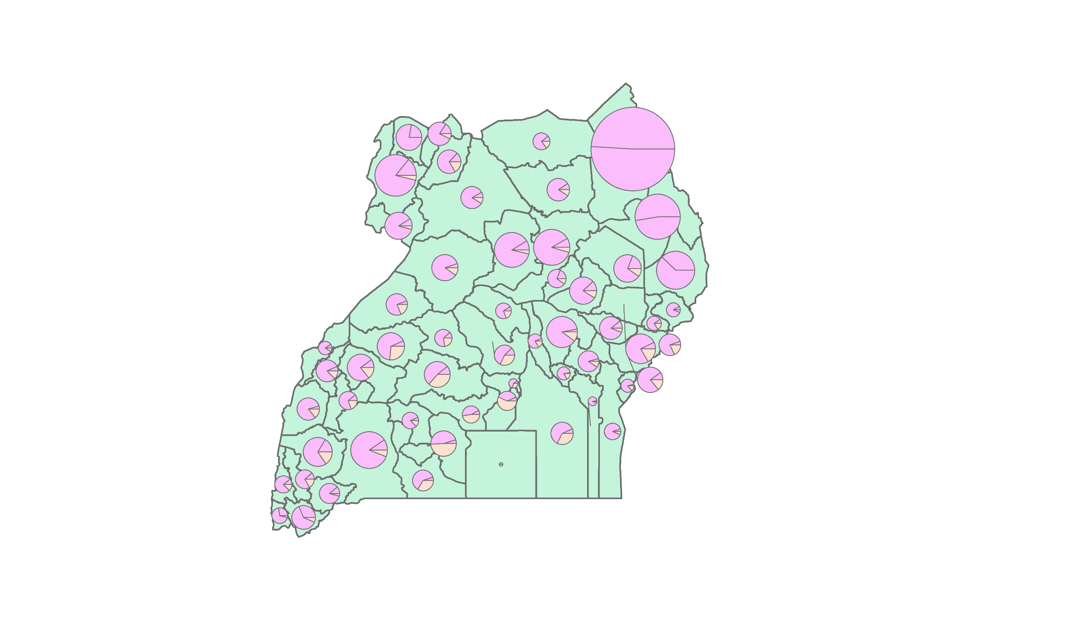
Missing all map elements.
Maybe you exported the data view
Needs work
5/10
Whatever the pinks are, they’re too close together
Need more contrast between the three colors
Missing Lake Victoria
Green/teal background is pretty bright

Slide 3
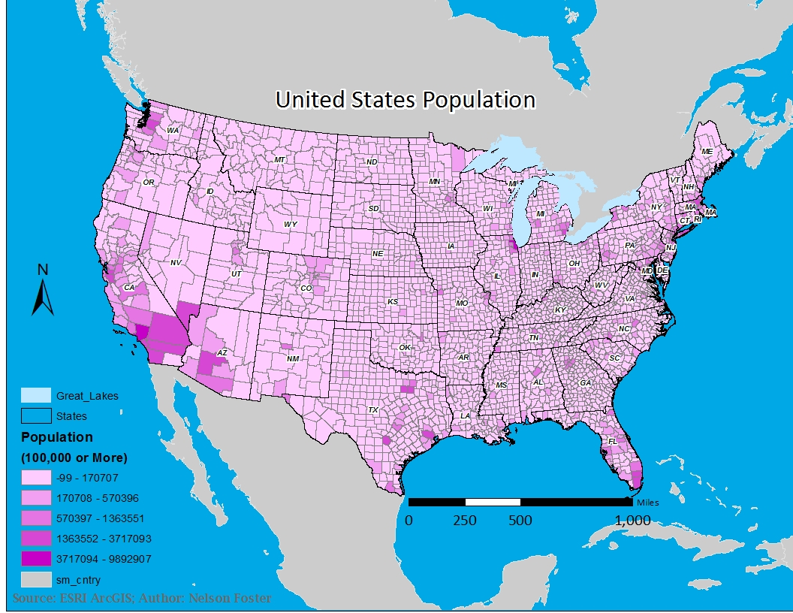
Could zoom in more on the US, lots of extra space in Canada and Mexico
I’d remove the county outlines, there are so many you lose them
Getting there but needs some work
7/10
Don’t need Great_Lakes, State or sm_cntry on legend
Ocean color too bright
Best to have round numbers,
Makes it easier to read:
0 – 170,000
170,001 – 580,000
etc
What does 100,000 or more mean?
Should take out -99 values
Should specify somewhere this is counties
Scale bar a bit big, little distracting
Need date too

